Slide 1
Department of Applied Mathematics and Computational Sciences
III Sem M.Sc.Software Systems
Transform Techniques
Dr. V. Suresh kumar

Slide 2
Transform of Integrals

Slide 3




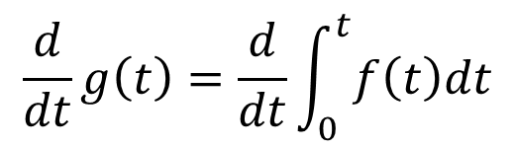
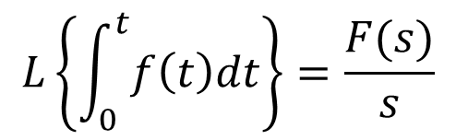
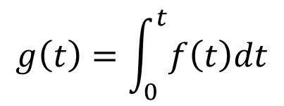
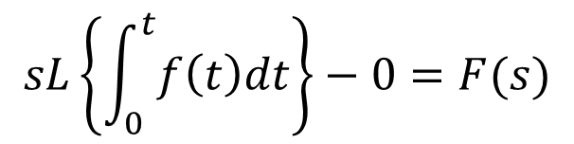
Statement
If $L\left\{f\left(t\right)\right\}=F(s)$ then $L\left\{\int_{0}^{t}{f\left(t\right)dt}\right\}=\frac{F(s)}{s}$
Proof:
Given
$$sL\left\{g\left(t\right)\right\}−g\left(0\right)=F(s)$$
$$L\left\{f\left(t\right)\right\}=F(s)$$
Take
$$sL\left\{\int_{0}^{t}{f\left(t\right)dt}\right\}−0=F(s)$$
$$g\left(t\right)=\int_{0}^{t}{f\left(t\right)dt}$$
$$\frac{d}{dt}g\left(t\right)=\frac{d}{dt}\int_{0}^{t}{f\left(t\right)dt}$$
$$L\left\{\int_{0}^{t}{f\left(t\right)dt}\right\}=\frac{F(s)}{s}$$
$$g′\left(t\right)=f(t)$$
$$L\left\{g′\left(t\right)\right\}=L\left\{f(t)\right\}$$

Slide 4
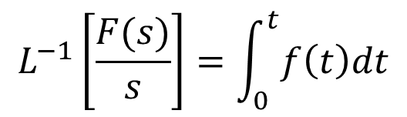
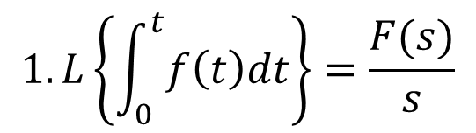
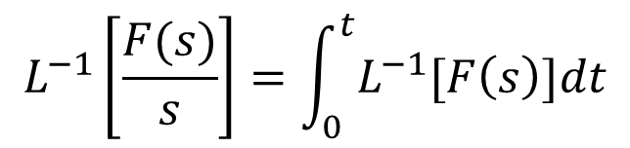
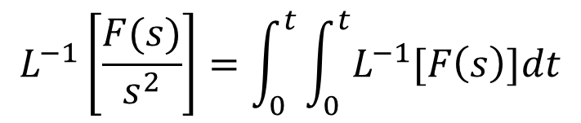
Note:
$$1.L\left\{\int_{0}^{t}{f\left(t\right)dt}\right\}=\frac{F(s)}{s}$$
$$L^{−1}\left[\frac{F(s)}{s}\right]=\int_{0}^{t}{f\left(t\right)dt}$$
$$L^{−1}\left[\frac{F(s)}{s}\right]=\int_{0}^{t}{L^{−1}[F\left(s\right)]dt}$$
$$L^{−1}\left[\frac{F(s)}{s^{2}}\right]=\int_{0}^{t}{\int_{0}^{t}{L^{−1}[F\left(s\right)]dt}}$$
This can be extended for higher orders

Slide 5

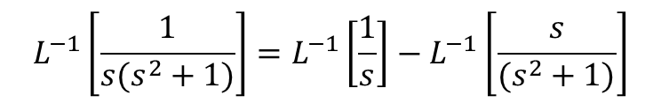
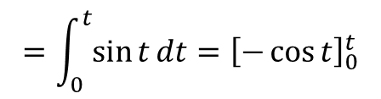
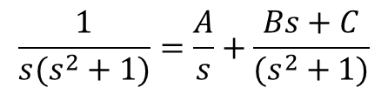

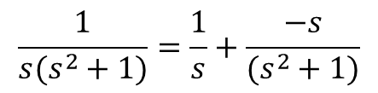
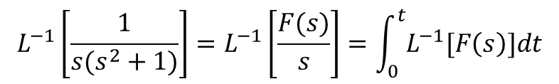
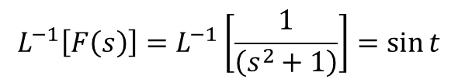





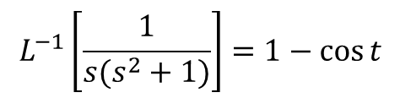


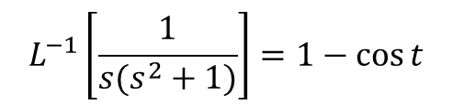
Examples
$$\frac{1}{s(s^{2}+1)}=\frac{1}{s}+\frac{−s}{(s^{2}+1)}$$
1. Find the Inverse Laplace Transform of $\frac{1}{s(s^{2}+1)}$
$$L^{−1}\left[\frac{1}{s(s^{2}+1)}\right]=L^{−1}\left[\frac{1}{s}\right]−L^{−1}\left[\frac{s}{(s^{2}+1)}\right]$$
Sol:
$$\frac{1}{s(s^{2}+1)}=\frac{A}{s}+\frac{Bs+C}{(s^{2}+1)}$$
$$L^{−1}\left[\frac{1}{s(s^{2}+1)}\right]=1−\cos{t}$$
$$1=A\left(s^{2}+1\right)+\left(Bs+C\right)s$$
OR
Put $s=0$
Take $F\left(s\right)=\frac{1}{(s^{2}+1)}$
We get $A=1$
$$L^{−1}\left[F\left(s\right)\right]=L^{−1}\left[\frac{1}{\left(s^{2}+1\right)}\right]=\sin{t}$$
Comparing the Coefficient of $s$ on both sides
$$L^{−1}\left[\frac{1}{s(s^{2}+1)}\right]=L^{−1}\left[\frac{F(s)}{s}\right]=\int_{0}^{t}{L^{−1}[F\left(s\right)]dt}$$
$$0=C$$
Put $s=1$
$$=\int_{0}^{t}{\sin{t}dt}={\left[−\cos{t}\right]}_{0}^{t}$$
We get 1$=1\left(2\right)+(B+0)(1)$
$$L^{−1}\left[\frac{1}{s(s^{2}+1)}\right]=1−\cos{t}$$
$$B=−1$$

Slide 6

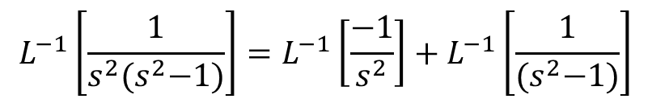
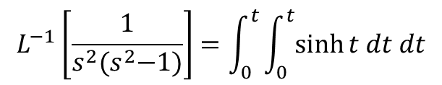



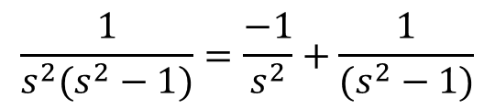

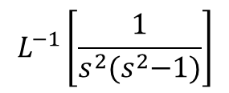
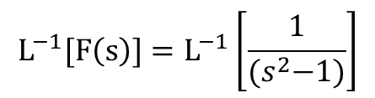
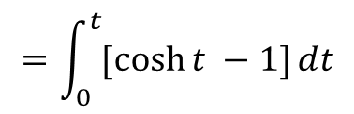

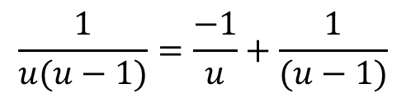
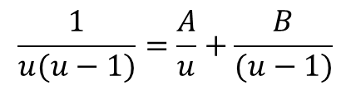



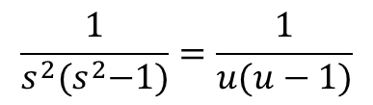

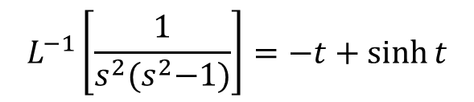
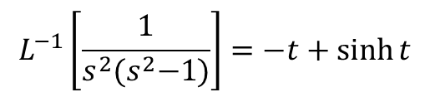
Examples cont…
$$\frac{1}{u(u−1)}=\frac{−1}{u}+\frac{1}{(u−1)}$$
$$=\int_{0}^{t}{{\left[\cosh{t}\right]}_{0}^{t}dt}$$
$$L^{−1}\left[\frac{1}{s^{2}{(s}^{2}−1)}\right]$$
2. Find
$$\frac{1}{s^{2}(s^{2}−1)}=\frac{−1}{s^{2}}+\frac{1}{(s^{2}−1)}$$
$$=\int_{0}^{t}{[\cosh{t −1]}dt}$$
Put $u=s^{2}$
$$L^{−1}\left[\frac{1}{s^{2}{(s}^{2}−1)}\right]=L^{−1}\left[\frac{−1}{s^{2}}\right]+L^{−1}\left[\frac{1}{{(s}^{2}−1)}\right]$$
$$\frac{1}{s^{2}{(s}^{2}−1)}=\frac{1}{u(u−1)}$$
$$={\left[\sinh{t −t}\right]}_{0}^{t}$$
$$L^{−1}\left[\frac{1}{s^{2}{(s}^{2}−1)}\right]=−t+\sinh{t}$$
$$\frac{1}{u(u−1)}=\frac{A}{u}+\frac{B}{(u−1)}$$
$$L^{−1}\left[\frac{1}{s^{2}{(s}^{2}−1)}\right]=−t+\sinh{t}$$
(OR)
$$1=A\left(u−1\right)+Bu$$
Take $F\left(s\right)=\frac{1}{{(s}^{2}−1)}$
Put $u=0$
$$A=−1$$
$$L^{−1}[F\left(s\right)]=L^{−1}\left[\frac{1}{{(s}^{2}−1)}\right]$$
Put $u=1$
$$=\sinh{t}$$
$$B=1$$
$$L^{−1}\left[\frac{1}{s^{2}{(s}^{2}−1)}\right]=\int_{0}^{t}{\int_{0}^{t}{\sinh{t dt dt}}}$$

Slide 7
Integration of Transform

Slide 8
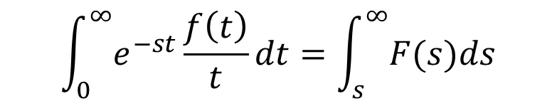
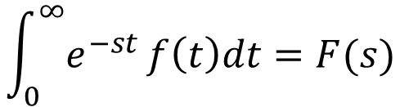
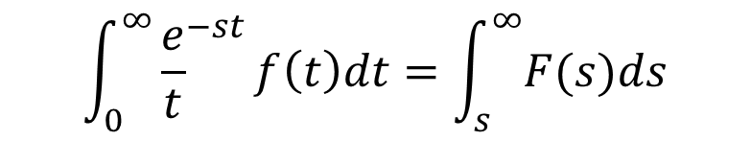
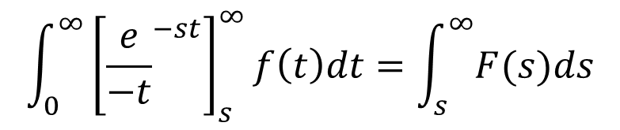
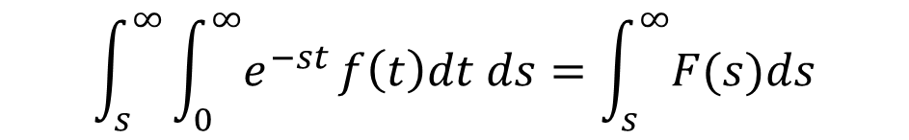
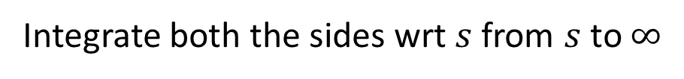
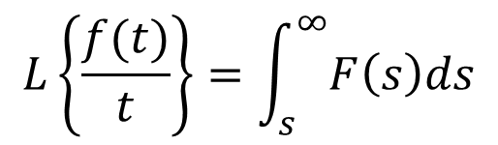
Statement
If $L\left\{f\left(t\right)\right\}=F(s)$ and $t\underset{→}{Lt}0^{+}\frac{f(t)}{t}$ exists then $L\left\{\frac{f(t)}{t}\right\}=\int_{s}^{∞}{F\left(s\right)ds}$
Proof:
$$\int_{0}^{∞}{{\frac{e}{t}}^{−st}}f\left(t\right)dt=\int_{s}^{∞}{F(s)ds}$$
We have
$$\int_{0}^{∞}{e^{−st}}f\left(t\right)dt=F(s)$$
$$\int_{0}^{∞}{e^{−st}}\frac{f\left(t\right)}{t}dt=\int_{s}^{∞}{F(s)ds}$$
Integrate both the sides wrt $s$ from $s$ to $∞$
$$\int_{s}^{∞}{\int_{0}^{∞}{e^{−st}}f\left(t\right)dt ds}=\int_{s}^{∞}{F(s)ds}$$
$$L\left\{\frac{f(t)}{t}\right\}=\int_{s}^{∞}{F\left(s\right)ds}$$
$$\int_{0}^{∞}{{\left[{\frac{e}{−t}}^{−st}\right]}_{s}^{∞}}f\left(t\right)dt=\int_{s}^{∞}{F(s)ds}$$

Slide 9
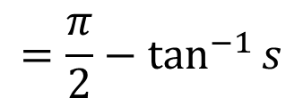
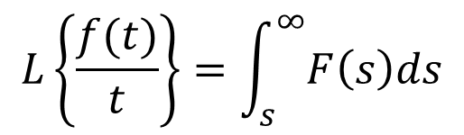
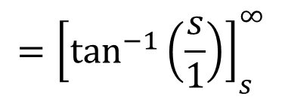
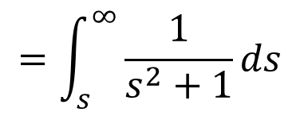
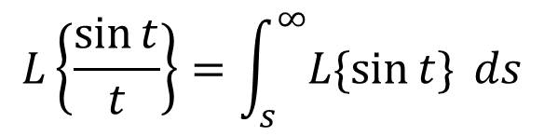

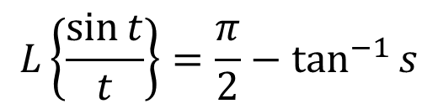
Examples
1. Find the Laplace Transform of $\frac{\sin{t}}{t}$
Ans:
$$={\left[\tan^{−1}\left(\frac{s}{1}\right)\right]}_{s}^{∞}$$
We have
$$L\left\{\frac{f(t)}{t}\right\}=\int_{s}^{∞}{F\left(s\right)ds}$$
$$=\frac{π}{2}−\tan^{−1}{s}$$
T$ake f\left(t\right)=\sin{t}$
$$L\left\{\frac{\sin{t}}{t}\right\}=\frac{π}{2}−\tan^{−1}{s}$$
$$L\left\{\frac{\sin{t}}{t}\right\}=\int_{s}^{∞}{L\{\sin{t\} }ds}$$
$$=\int_{s}^{∞}{\frac{1}{s^{2}+1}ds}$$

Slide 10
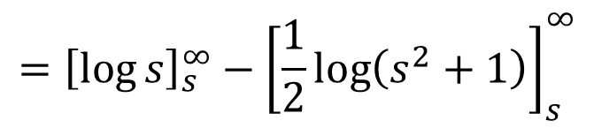
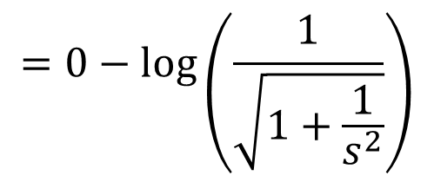
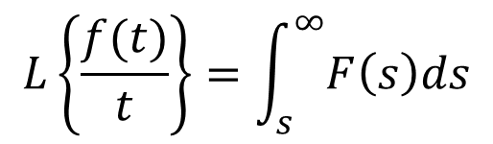
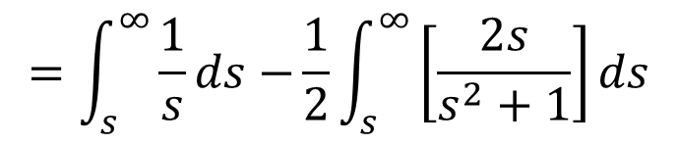
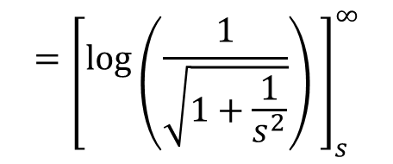
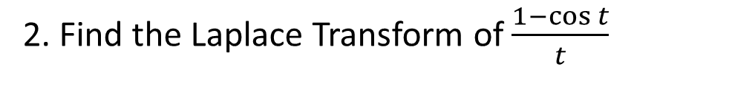
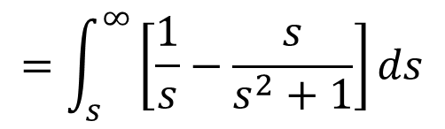
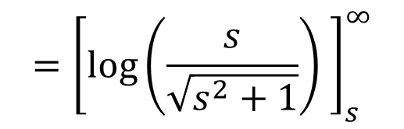
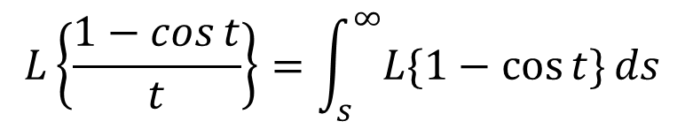





Examples cont…
$$={\left[\log{s}\right]}_{s}^{∞}−{\left[\frac{1}{2}\log\left(s^{2}+1\right)\right]}_{s}^{∞}$$
2. Find the Laplace Transform of $\frac{1−cos{t}}{t}$
$$={\left[\log{s}\right]}_{s}^{∞}−{\left[\log{{\left(s^{2}+1\right)}^{\frac{1}{2}}}\right]}_{s}^{∞}$$
Ans:
$$={\left[\log{s} −\log{{\left(s^{2}+1\right)}^{\frac{1}{2}}}\right]}_{s}^{∞}$$
We have
$$L\left\{\frac{f(t)}{t}\right\}=\int_{s}^{∞}{F\left(s\right)ds}$$
$$={\left[\log\left(\frac{s}{\sqrt{s^{2}+1}}\right) \right]}_{s}^{∞}$$
T$ake f\left(t\right)=1−cos{t}$
$$=log\left(\frac{1}{\sqrt{\frac{s^{2}+1}{s^{2}}}}\right)$$
$$L\left\{\frac{1−cos{t}}{t}\right\}=\int_{s}^{∞}{L\{1−\cos{t\}}ds}$$
$$={\left[\log\left(\frac{1}{\sqrt{1+\frac{1}{s^{2}}}}\right) \right]}_{s}^{∞}$$
$$=\int_{s}^{∞}{\left[\frac{1}{s}−\frac{s}{s^{2}+1}\right]ds}$$
$$L\left\{\frac{1−cos{t}}{t}\right\}=\log\left(\frac{s}{\sqrt{s^{2}+1}}\right)$$
$$=0−\log\left(\frac{1}{\sqrt{1+\frac{1}{s^{2}}}}\right)$$
$$=\int_{s}^{∞}{\frac{1}{s}ds−}\frac{1}{2}\int_{s}^{∞}{\left[\frac{2s}{s^{2}+1}\right]ds}$$

Slide 11

Examples cont…
3. Find the Laplace Transform of $\frac{\cos{t}}{t}$
Does not exist

Slide 12








Homework problems
Find the Inverse Laplace Transform for the following
Find the Laplace Transform for the following
1. $\frac{1}{s^{2}+\frac{s}{4}}$
1. $\frac{1−e^{t}}{t}$
2. $\frac{1}{s^{3}−{9s}^{2}}$
2. $\frac{2−2\cosh{t}}{t}$
3. $\frac{5}{s^{3}−5s}$
3. $\frac{2(1−\cos{t)}}{t}$
4. $\frac{1}{s^{4}−{4s}^{2}}$
5. $\frac{2}{s^{3}+9s}$

Slide 13


